Slide 1
Your GIMP Portfolio
Final Site

Slide 2
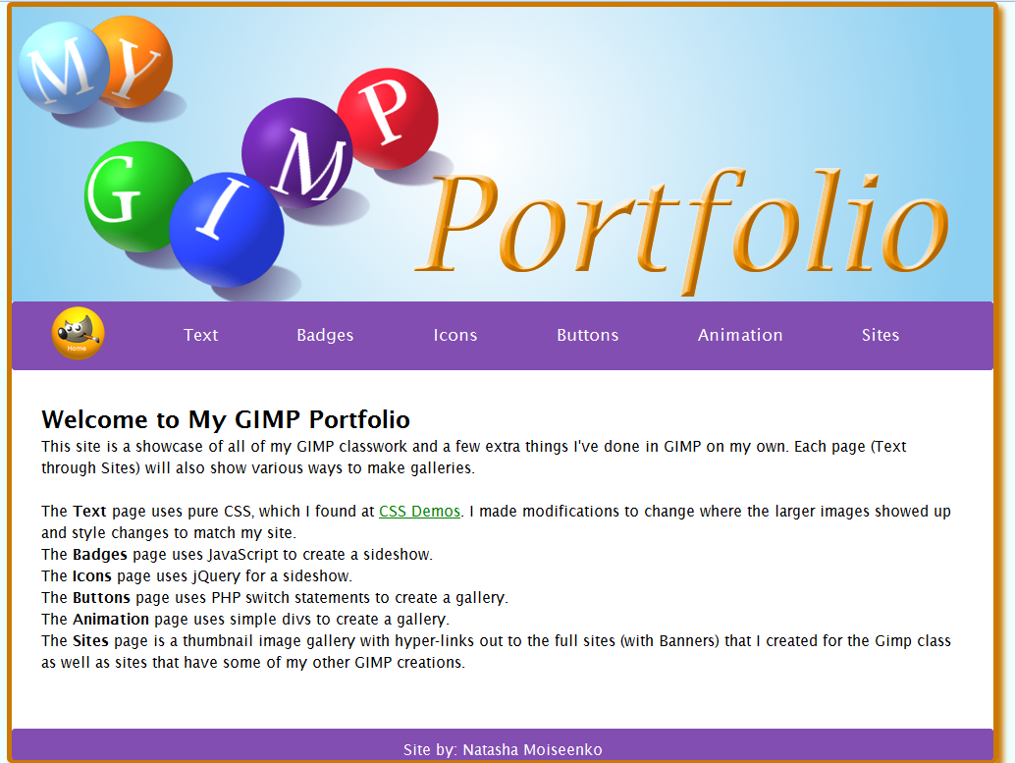
Now its time for you to create Your GIMP Portfolio site ☺
I used my banner and navigation that I created last time (although I made some change to the navigation bar).
Create your Index page and add your banner and navigation to it.
Then add some text that explains your site.
Create the rest of your site pages using html or PHP.

Slide 3
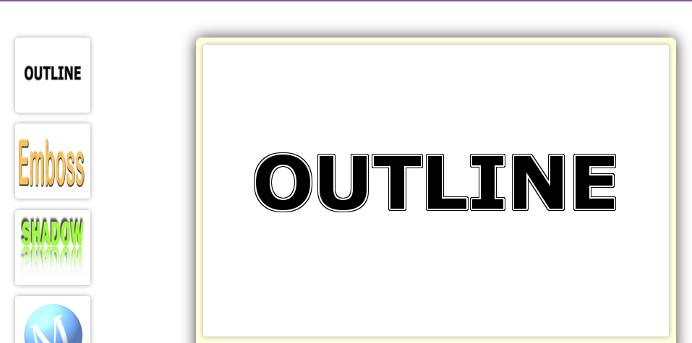
On my Text page I wanted to use plain CSS to create a gallery. I found this while looking around the web. http://cssdemos.tupence.co.uk/image-popup.htm
When I hover over a thumbnail image the larger image pops up.
I made some changes from the original code.
I made my thumbnails into one vertical line and had the popups show to the right instead of above.
Note: this is not something you have to do, just an example or what you can do.
This is your portfolio, have fun !! ☺

